Slide 1
CRITICAL EVALUATION OF JOURNAL ARTICLE
BY
DR.G.AARTHIPRIYANKA
POST GRADUATE
DEPARTMENT OF PHARMACOLOGY

Slide 2
Drug induced hepatotoxicity: effect of polyherbal formulations
Pharmacognosy magazine
Volume 4,issue 19,July-sep 2009

Slide 3
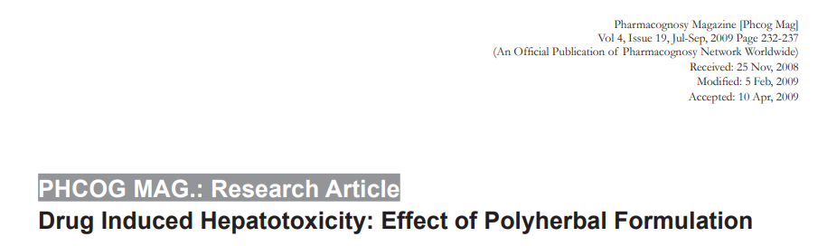
TITLE
SUGGESTED TITLE:
Effect of polyherbal formulation on methotrexate induced hepatotoxicity in wistar rats.

Slide 4
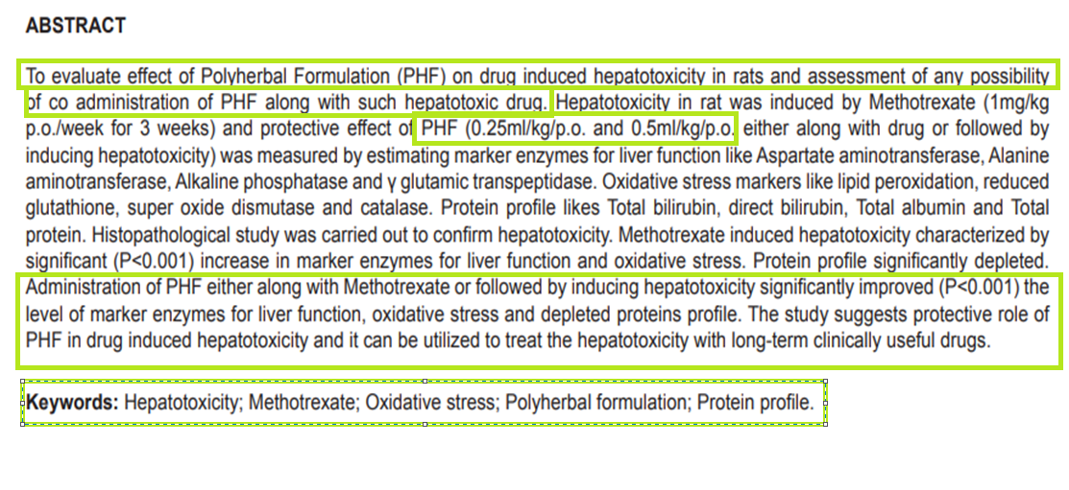

ABSTRACT
Type and dosage of extract used
Species of animal used
Research Objective Key methods
Principle Finding
Background of study.

Slide 5
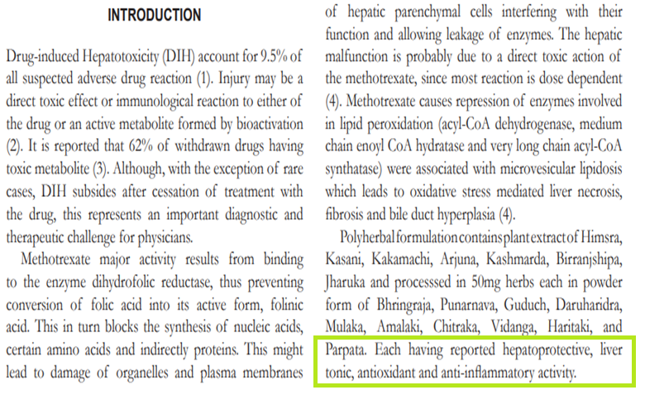
INTRODUCTION . Background
Sufficient scientific background and rationale of the study along with relevant references to previous study.
Rationale of using the animal species and its study relevance to human biology.
Other properties of the polyherbal formulations
.

Slide 6
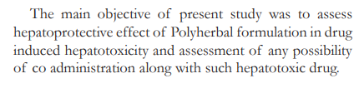
Objectives
objectives of the study

Slide 7
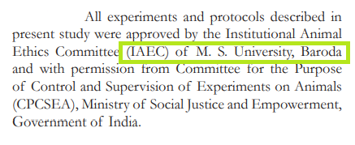

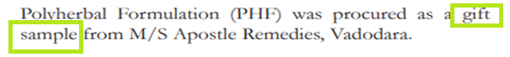
METHODS
Ethical Statement
Ethical committee approval
Background of Plant materials

Slide 8
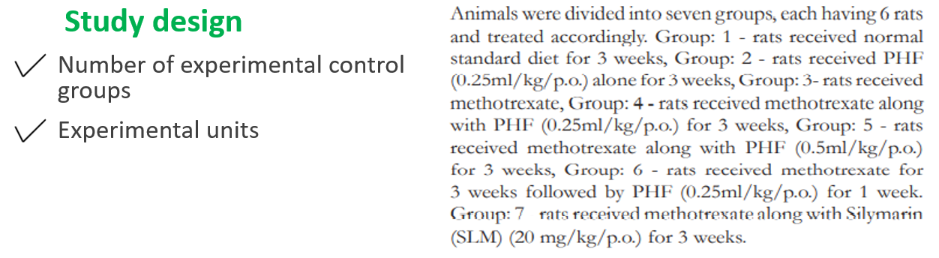
6 Rats in 7 groups
GROUP 1 | GROUP 2 | GROUP 3 | GROUP 4 | GROUP 5 | GROUP 6 | GROUP 7
normal standard diet for 3 weeks | PHF 0.25ml/kg/ p.o alone for 3 weeks | Methotrexate (1 mg/kg/week) for 3 weeks | Methotrexate along with PHF 0.25ml/kg/ p.o for 3 weeks | Methotrexate along with PHF 0.5ml/kg/ p.o for 3 weeks | Methotrexate for 3 weeks followed by PHF 0.25ml/kg/ p.o for 1 week | Methotrexate along with SILYMARIN(SLM) (20/mg/kg/p.o) for 3 weeks

Slide 9
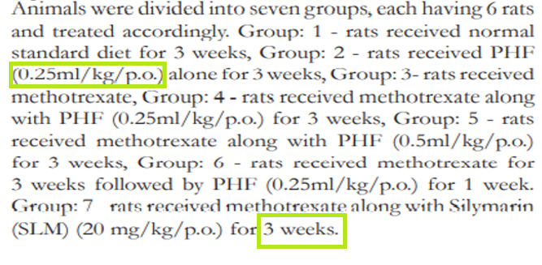
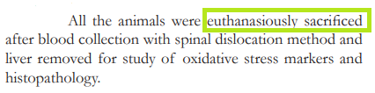
Experimental Procedure
Drug formulation and dose
Site and route of administration
Timing of administration
Method of Euthanasia

Slide 10
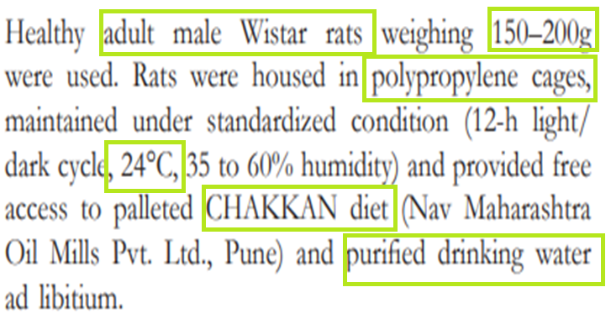
Experimental Animals
Species
Sex of the animal
Weight
Strain
Source of Animal
Genetic Modification Status, Genotype, Immune Status, Drug or test naïve
Housing & Husbandry
Temperature
Type of food
Access to food and water
Type of facility

Slide 11
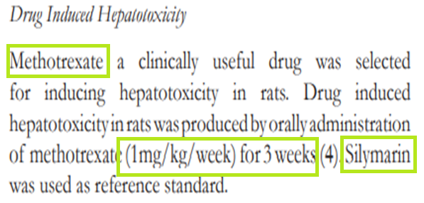

Slide 12
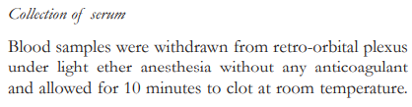
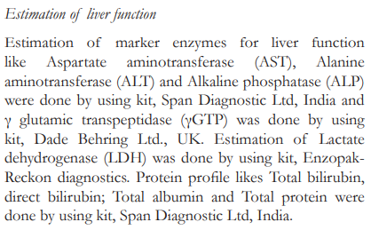
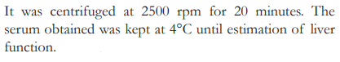
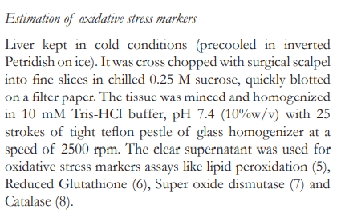
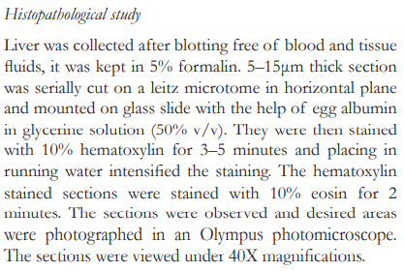

Slide 13
Sample Size
Total Number of Animals in each experiment and each experimental group.
Sample size calculation
Allocation of Animals
Randomisation or matching
Experimental Outcomes
Primary and Secondary Experimental outcomes defined

Slide 14
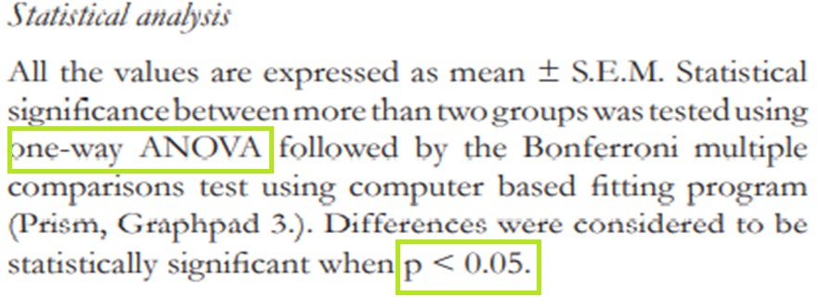
Statistical Methods
One way ANOVA is used to determine statistical significance
p value < 0.05 is considered statistically significant

Slide 15
RESULTS
Baseline Data
Explained
Numbers Analysed
Absolute number of animals in each group are reported
Outcomes and Estimation
Results for each analysis are carried out with a laboratory analysis
Adverse Event
occurrence of adverse event not reported

Slide 16
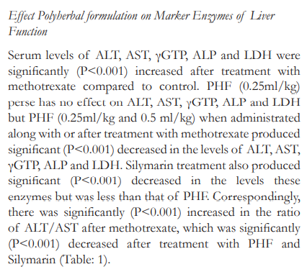
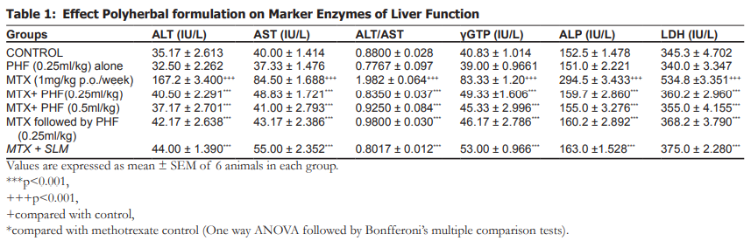

Slide 17
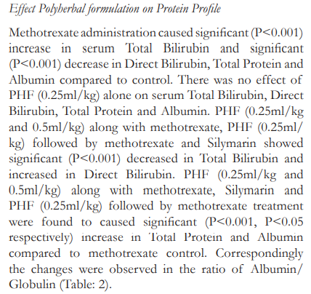
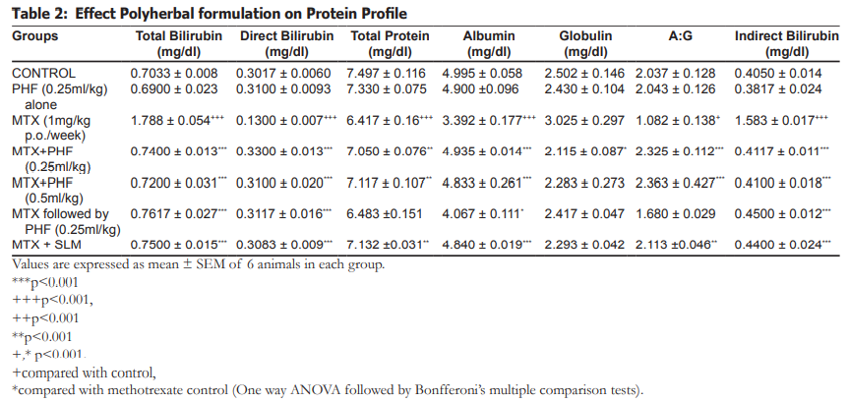

Slide 18
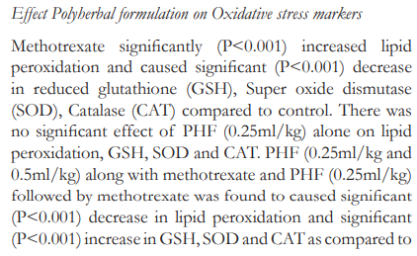
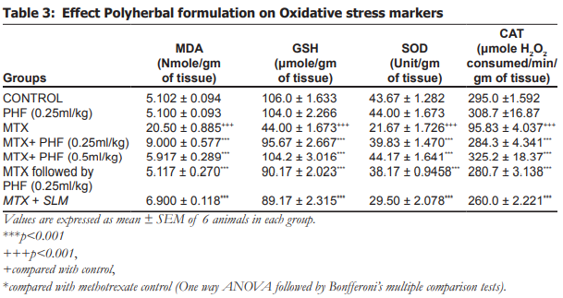
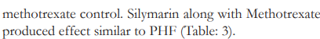

Slide 19
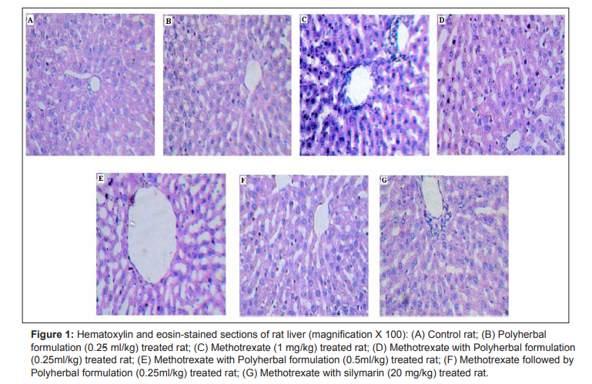
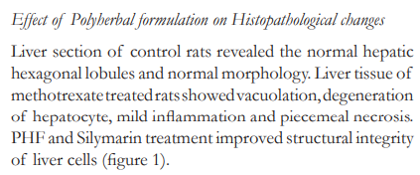

Slide 20
DISCUSSION
Interpretation
The results were precisely interpreted.
Study Limitation- mechanism of polyherbal formulation action is not defined
Funding
Funding sources are not mentioned

Slide 21
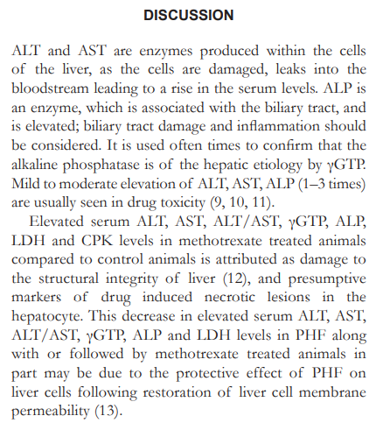
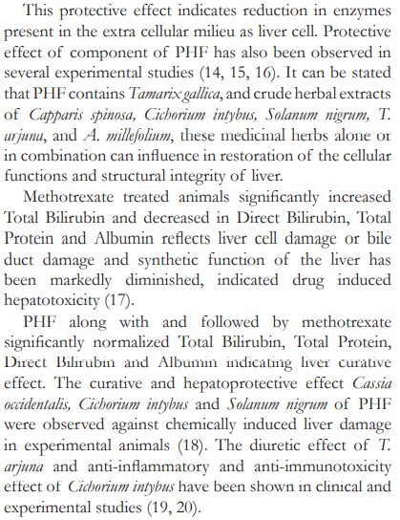

Slide 22
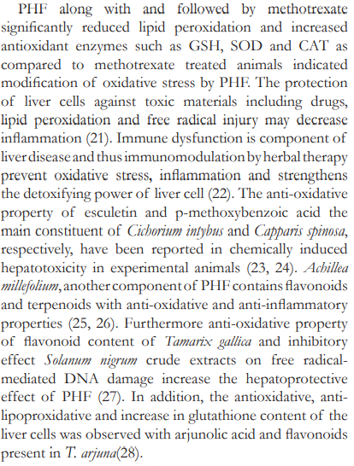
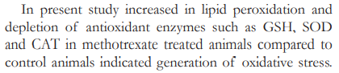
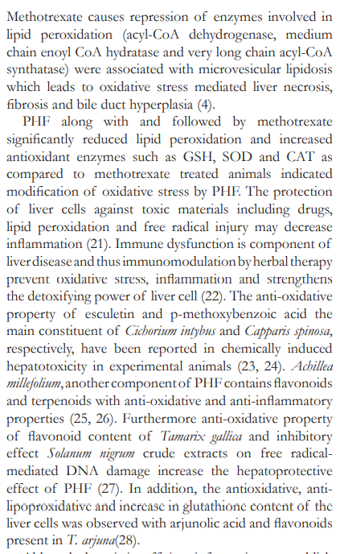

Slide 23
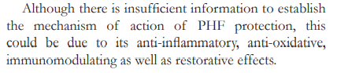
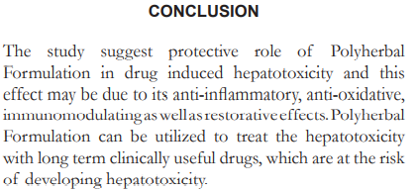

Slide 24
REFERENCE
Vancouver style followed

Slide 25
THANK YOU

